Slide 1
HOME PAGE
CUSTOMER
ADMIN
ABOUT US
CONTACT US

Slide 2
CUSTOMER
Login ID :
Password :
LOGIN
New user(Register)

Slide 3
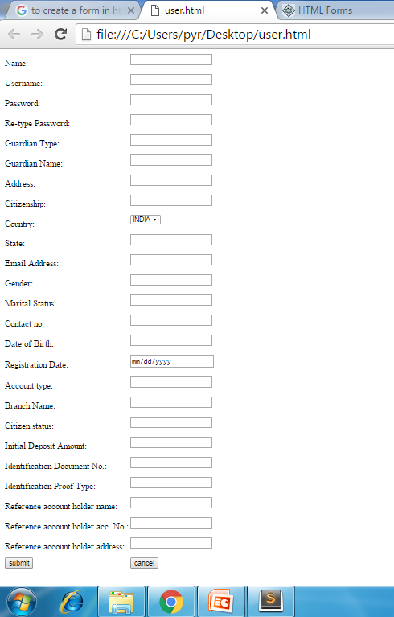
NEW USER REGISTER

Slide 4
NEW USER REGISTER
Name:
User Name:
Password:
Retype Password:
Guardian Type:
Guardian Name:
Address:
Citizenship:
State:
Country:
Email Address:

Slide 5

Gender:
Marital Status:
Contact No:
Date Of Birth:
Registration Date:
Account Type:
Branch Name:
Citizen Status:
Initial Deposit Amount:
Identification Proof Type:
Identification Document Number:

Slide 6
Reference Account Holder Name:
Reference Account Holder Acc.No:
Reference Account Holder Address:
Submit
Cancel

Slide 7
CUSTOMER
LOAN
TRANSACTIONS
ACCOUNT UPDATION
STATEMENT GENERATION

Slide 8
APPLY LOAN
Loan Type :
Educational Loan
Personal/Housing Loan
Loan Amount :
Loan Apply date :
Loan issue date :
Rate of interest :
6.8%
Duration :

Slide 9
APPLY EDUCATIONAL LOAN
Loan Type :
Educational Loan
Personal/Housing Loan
Course fee :
Course :
Father’s Name :
Father’s Occupation :
Father’s Total Experience :
Father’s Experience with current company:
Ration Card number :
Annual Income :
Submit
Cancel

Slide 10
APPLY PERSONAL/HOUSING LOAN
Loan Type :
Educational Loan
Personal/Housing Loan
Annual Income :
Company Name :
Designation :
Total Experience :
Experience with current company :
Submit
Cancel

Slide 11
TRANSACTIONS
A/c Number :
A/c Name :
A/c Type :
Transaction Id :
1A2B3C
Transaction Type:
Amount :
Submit
Cancel

Slide 12
UPDATION
Customer Id:
Name:
Account Number:
Country:
State:
Gender:
Date of Birth:
Registration Date:
Bank Name:
Branch Name:
IFSC Code:
v
vv

Slide 13
Identification Proof Type :
Identification Doc. Number:
Reference :Account holder Name:
Reference :Account holder Acc.No:
Reference :Account holder Address:
Address:
Contact Number:
Mail Id:
Marital Status:
Account Type:
Citizenship:

Slide 14
Citizen Status :
Guardian Type:
Guardian Name:
Account Type:
vvv
v
Submit
Cancel

Slide 15
STATEMENT GENERATION
From :
To:
Transaction Type :
View
Download
Transaction Date | Description | Transaction Type | Amount

